Slide 1


C programming

Slide 2


INTRO
What is C?
Bell Laboratories
1972
Dennis Ritchie

Slide 3

Why Learn C?
Popular programming languages
Helps to learning other languages
Very Fast

Slide 4
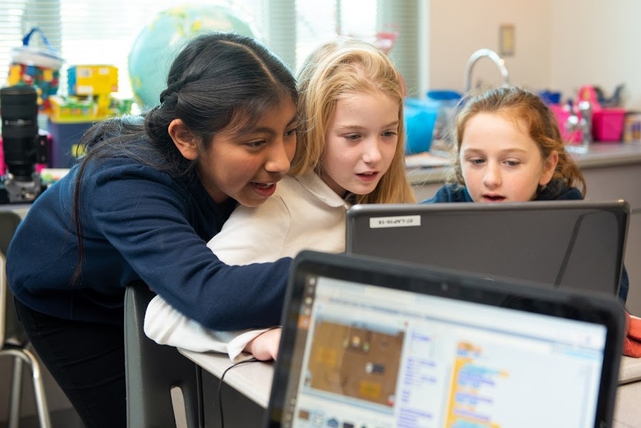
Why should CSE students learn C programming?
Learning C programming essential skills and knowledge that are foundational for our education and future careers in the field of computer science and engineering.

Slide 5
C Get Started
To start using C, need two things: I) A text editor, like Notepad, Code Blocks, VS Code to write C code
II) A compiler, like GCC, to translate the C code

Slide 6
Syntax
#include<stdio.h> int main() { printf("Hello World!"); return 0; }

Slide 7
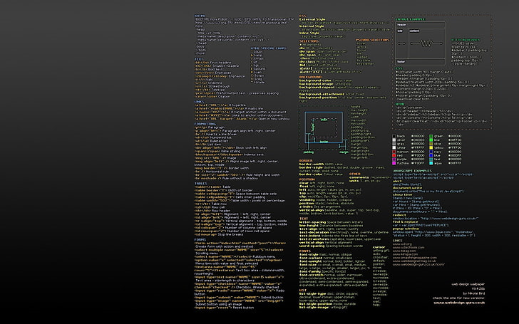
Escape Sequence
\t Creates a horizontal tab \\ Inserts a backslash character (\) \" Inserts a double quote character

Slide 8

comments
// Single-line comments /* */ Muti-line comments

Slide 9
variables
int Stores integers float Stores floating point numbers char Stores single characters

Slide 10
Format specifiers
Variable | Format Specifiers
int | %d
float | %f
char | %c
string | %s

Slide 11
Variable Names (Identifiers)
Names can contain letters, digits and underscores
Names must begin with a letter or an underscore (_)
Names are case-sensitive (myVar and myvar are different variables)
Names cannot contain whitespaces or special characters like !, #, %, etc.
Reserved words (such as int) cannot be used as names

Slide 12

Data types
Data Type | Size | Description | Example
int | 2 or 4 bytes | Numbers without decimals | 1
float | 4 bytes | Fractional numbers(storing 6-7 decimal digits) | 1.99
double | 8 bytes | Fractional numbers(storing 15 decimal digits) | 1.99
char | 1 bytes | Single character/letter/number or ASCII values | 'A'

Slide 13
If...else
Syntax if (condition) { // block of code to be executed if the condition is true } else { // block of code to be executed if the condition is false } Example int time = 20; if (time < 18) { printf("Good day."); } else { printf("Good evening."); } // Outputs "Good evening."

Slide 14
User input
Example // Create an integer variable that will store the number we get from the user int myNum; // Ask the user to type a number printf("Type a number: \n"); // Get and save the number the user types scanf("%d", &myNum); // Output the number the user typed printf("Your number is: %d", myNum);

Slide 15
Thank You Md. Rakibul asib redoy 011221177
mredoy221177@bscse.uiu.ac.bd

